Slide 1
Junior To Do List
Class of 2024
April 24th, 2023
6:30 pm
PRHS Media Center
Notes:
AL

Slide 2
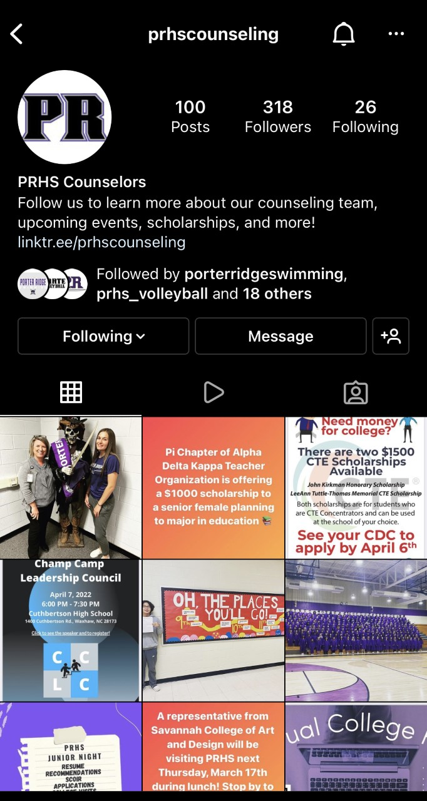
Before we begin…
Are you following us on Instagram?!
prhscounseling
Pirates2College
Follow us to stay updated on:
College visits
Events
Scholarships and opportunities
Registration/class schedule info
Helpful information
Notes:
AL

Slide 3
Notes:
AL

Slide 4
SCOIR
Scoir can be accessed from the student start-up page. Just click the Scoir tile.
Students will use Scoir for many reasons, including:
Telling counselors which schools they’re applying to by putting schools in their Applying list. This lets the counselors know where to send transcripts and other school documents
Requesting letters of recommendation from teachers
Students can complete their College Preferences list. This lets them indicate their Must-Haves for schools (ex. Size, location, majors, etc)
Put schools you’re interested in into your Following list so you can keep track and see more information about them
Update personal details and INVITE PARENTS!!!
Notes:
MJ

Slide 5
Creating A Resume
EVERYONE needs a RESUME!!! These should be FINALIZED over the summer - this way you are READY for the application process when you start your SENIOR YEAR!!!
Most of you should have already started your resume while in Advisory. If not you can get started using SCOIR!
Resumes are used for:
Summer Employment
College Applications
Internship & Job Shadowing Experiences
Scholarship Applications
Recommendation Letters from Counselors, Teachers, and Other Recommenders
Notes:
MJ

Slide 6
Speaking of College Visits...
If you follow us on Instagram you will get reminders about which schools are visiting PRHS!!
prhscounseling
Notes:
AG

Slide 7
College Visits
It is important to visit the schools that you are interested in attending
Some schools may not even consider your application if you don’t show some form of interest
All colleges and universities have scheduled Open Houses or you can schedule your own personal tour through admissions
This is a great activity to plan during your summer break!
Notes:
AG

Slide 8
ACT & SAT Scores
Most NC colleges and universities are TEST OPTIONAL!
Check other states
To know exactly what that means per college or university you need to contact them directly or check out their website
Scores will still be used for scholarship opportunities directly from the institution and/or Honors College options and can significantly affect the amount of money you receive
Notes:
ES

Slide 9
Recommendations
Many colleges and universities will require letters of recommendation. Resumes are extremely helpful when writing a letter of recommendation.
Recommendations from counselors, teachers, coaches, and community leaders include information about your character, personal strengths, or unique qualities that are helpful to admissions committees.
When selecting a teacher, coach, or community member to write your letter of recommendation, make sure to give them enough advance notice! NO LESS THAN TWO WEEKS!!!
Notes:
ES

Slide 10
Recommendations
When you return to PRHS for your SENIOR YEAR you will request recommendation letters from your assigned counselor and teachers face to face. In addition, you will enter the requests into SCOIR (more info to follow)
SENIOR NIGHT will be in September. The date and time will be announced in AUGUST!!
Summer Homework - determine which teacher should complete your recommendations!!! And make sure you’ve prepared the resume and other materials you want to share with them
Notes:
ES

Slide 11
The Financial Aid Process
Financial Aid is money that will help you pay for college and comes as Grants/Scholarships, Loans, or Work Study
All parents/students must fill out the Free Application for Federal Student Aid (FAFSA) to qualify for ANY aid
Parents may already have an account from older siblings or themselves, and they should use the same one!
FAFSA will open December 2023 - this is NEW!!!!
It will look a little different from previous years
The most important thing to remember is to never pay for a scholarship or for scholarship information.
A list of scholarships is located on the PRHS Website under the Scholarships and in the weekly Pirate Press.
Notes:
ES

Slide 12
In a minute you’ll be learning about scholarships...
prhscounseling
Notes:
AL

Slide 13
Things to Keep in Mind About Scholarships
Scholarships will be listed on the School Counseling page in addition to other websites like CFNC and scholarships.com
If you qualify for a scholarship then apply for it!
Reuse your scholarship essays to save time
Find out how the college(s) you apply to handle their scholarship applications
Grades/GPA aren’t everything! Most scholarships want to see community service and leadership experience as well.
NEVER pay for a scholarship or scholarship information!
Notes:
AL

Slide 14
Application Process & Essays
Most applications will not open before August 1st, 2023
Wingate is one exception
Many applications will be filled out through Common Application
Personal Info and Essays through Common App can be completed over the summer, but NOT college specific info
If a college or university requires essays or a personal statement it will be read. Make sure to put a lot of thought into these writings. Have someone proofread to check grammar, spelling, and content.
Other online application portals include - SENDEDU, Coalition, CFNC, SCOIR, and College/Universities Websites
Notes:
ES

Slide 15
PRHS Internships
Internships are available to PRHS students during the summer, fall or spring semester
Internships provide students with an opportunity to earn high school college prep elective credit and gain work experience in a career field of interest.
Internship Grades are based on required assignments, attendance at scheduled meetings and employer evaluation
Notes:
AL

Slide 16
PRHS Internships
Internship Qualifications:
Good attendance record (no more than 7 absences in a semester for the last 2 years)
Reliable transportation
No suspensions or serious disciplinary actions on your high school record
At least a 2.5 GPA
Able to commit to attend at least 8 hours a week during your internship
Notes:
AL

Slide 17
Career Exploration Resources
PRHS students interested in career exploration have access to the MajorClarity website. This site can be accessed through CLEVER in PowerSchool.
The site features career videos/activities that can assist students as they begin to explore college majors & careers. It also helps students with career and learning style inventories, resume writing, scholarship searches, and is where students apply for internships.
Please contact Mrs. Sarah Webb in the Counseling Office or via email sarah.webb@ucps.k12.nc.us or phone 704.292.7662 ext. 7010 should you have questions regarding internships or need MajorClarity assistance
Notes:
AL

Slide 18
What is Career and College Promise (CCP)?
Career and College Promise (CCP) allows high school students, grades 11-12, to earn college credit while still enrolled in high school, FOR FREE. ​
Books are not included! Students are responsible for purchasing their own course materials​
After purchasing textbooks, you can come by the counseling office for a form to receive $50 back from your purchase!
Student must have 2.8 unweighted GPA to be eligible
The CCP program offers many different pathways for students to choose from based on their individual goals under two main categories: ​
College Transfer Pathways (CTP) and​
Career and Technical Education (CTE) Certificates.​
Notes:
AG

Slide 19
Interested?
For more information, please read through the ​
SPCC NC Career and College Promise Program Guide​
This guide has everything you need to know, including eligibility, all the pathways (and courses) available to CCP students and much more! ​
​
Shannon Mincik
Career Coach​
At PRHS every Tuesday Morning & All Day Wednesday’s
SMinick@spcc.edu​
704.290.5871
Notes:
AG

Slide 20
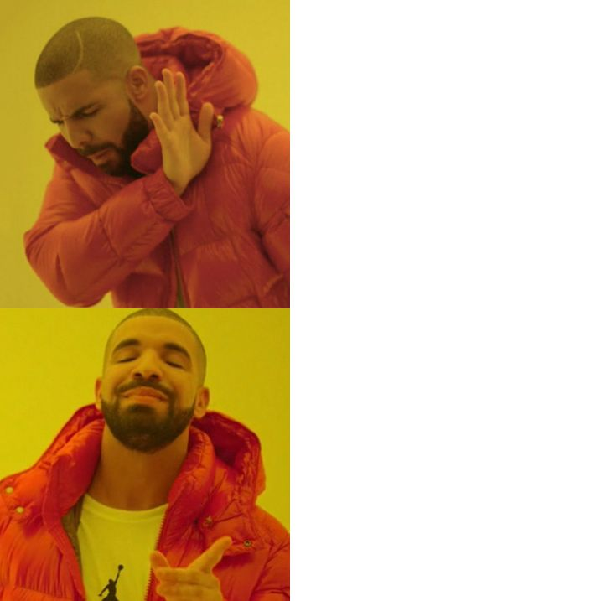
You made it to the end of the presentation!!
Students who don’t follow PRHS Counseling on Instagram
One more thing before you leave...
FOLLOW US ON INSTAGRAM!
Students who stay informed by following PRHS Counseling
prhscounseling
Notes:
AL

Slide 21
JUNIOR TO DO LIST
WHAT IS YOUR AFTER HIGH SCHOOL PLAN?!?
CREATE RESUME
WHO WILL WRITE YOUR RECOMMENDATION?!?
SCHEDULE COLLEGE VISITS
LOG INTO SCOIR AND FOLLOW SCHOOLS
RESEARCH SCHOLARSHIPS ON PRHS WEBSITE OR VIA PIRATE PRESS
Notes:
AL + MJ

Slide 22
THANK YOU!!!
QUESTIONS?!?
bit.ly/UCPSCollegeAdvising
Notes:
AL + MJ

